Slide 1




Predicting Customers Booking Behavior with British Airways
British Airways Data Science Job Simulation on Forage
by Tito Dwi Syahputra

Slide 2
Table of Contents
01
02
03
04
05
Introduction
Data Understanding
Exploratory Data Analysis
Getting to know the problem we want to tackle
Getting to understand to the given dataset
Uncover meaningful insights that might be found
Modeling
Recommendations
Building, Evaluating, and Interpreting LightGBM model
Recommendations for British Airways

Slide 3
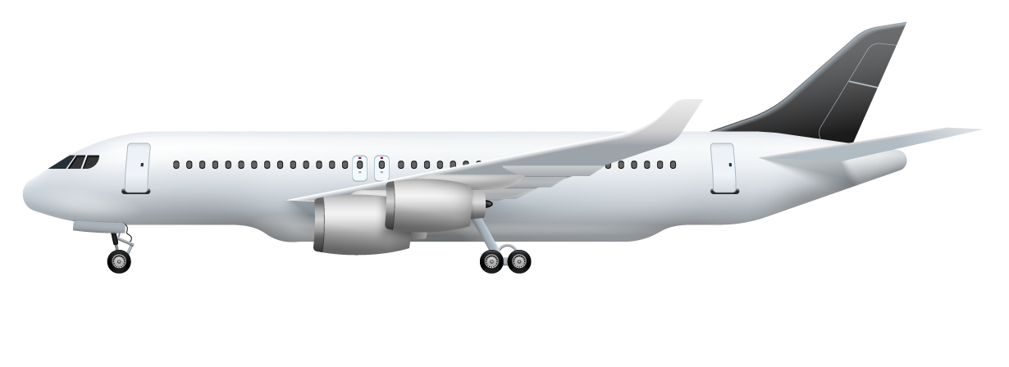
01
Introduction
Getting to know the problem we want to tackle

Slide 4
Business Problem
Booking Flight
Average Seat Capicity on British Airways
0
45
300
15% Completed
WHAT A WASTE OF RESOURCES! Only 45 out of 300 total seats on an airplane used for a single flight!
85% Not Completed
British Airways need to do Resource Optimization!
But HOW?

Slide 5
Solution
Predictive Analytics
Efficient Resource Allocation
More Profit Made
Build a robust Machine Learning model to predict customers booking behaviour.
Reduce operational costs, and Maximize overall profitability.
Optimize routes/schedules, and
Allocate aircraft, crew, and fuel to meet the expected demand.
This is our main objective as a Data Scientist!

Slide 6
Key Success Metric For Modeling
 |  | Predicted: NOT Completed | Predicted: Completed
 | Actual: NOT Completed | True Negative | False Positive
 | Actual: Completed | False Negative | True Positive
Minimize empty seats
Minimize overload customers
We want to minimize False Negative and False Positive as many as possible!
F1-Score

Slide 7
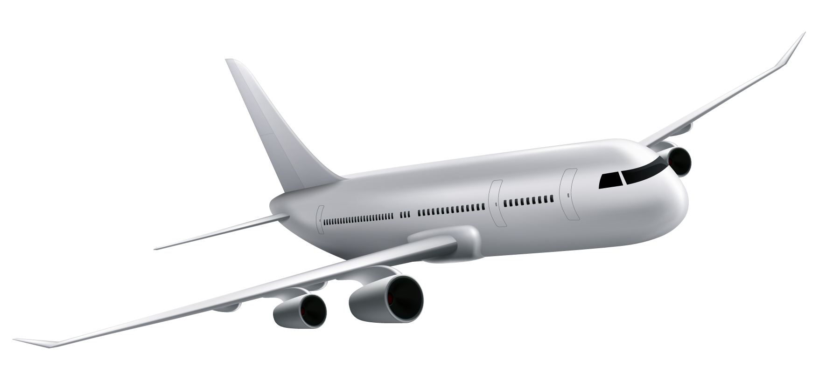
02
Data Understanding
Getting to understand to the given dataset

Slide 8



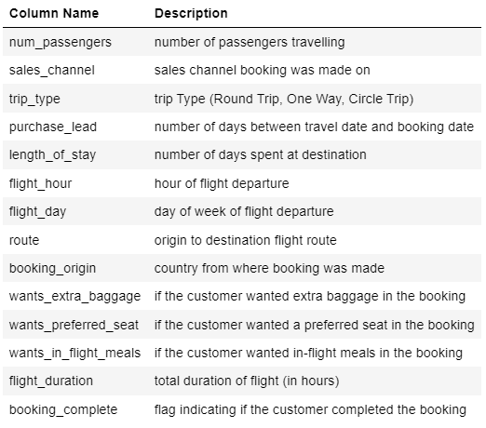
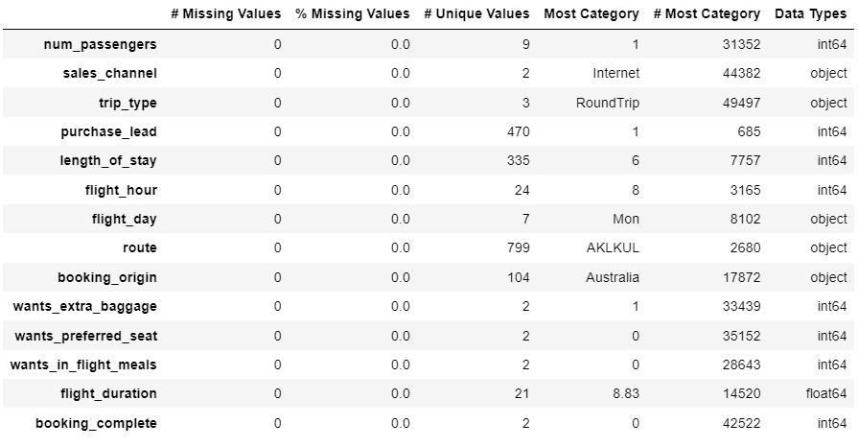
Data Profiling
50000 rows
13 features & 1 target variable
Check Missing Values – 0 NaN are found
Check Data Types – Types are good
Check Duplicated Rows – 1625 duplicates are removed
Check columns having too many unique categories – route & booking_origin columns
49281 rows
13 features & 1 target variable

Slide 9

03
Exploratory Data Analysis
Uncover meaningful insights that might be found

Slide 10
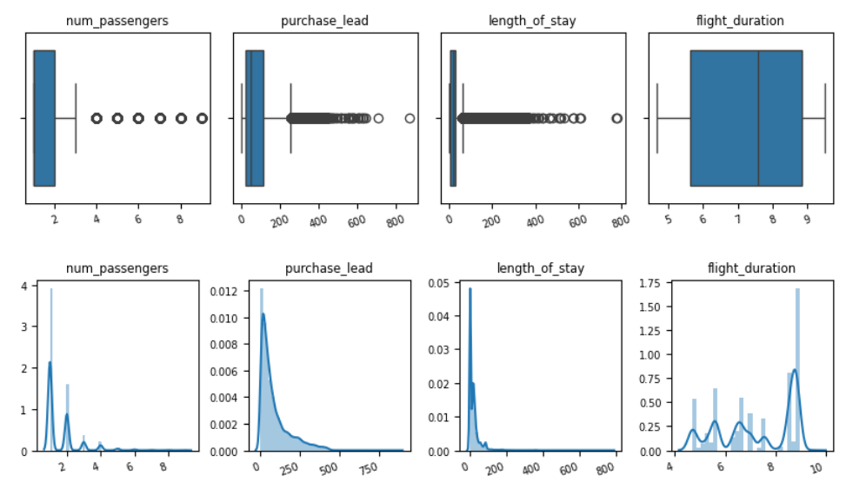


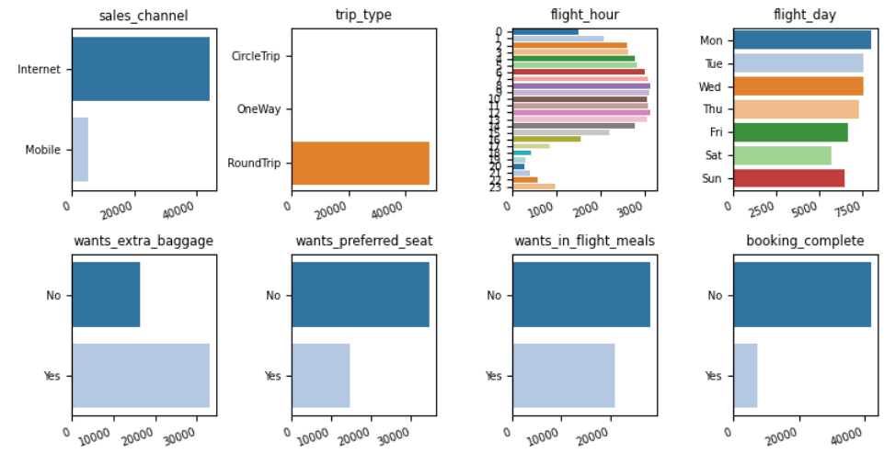
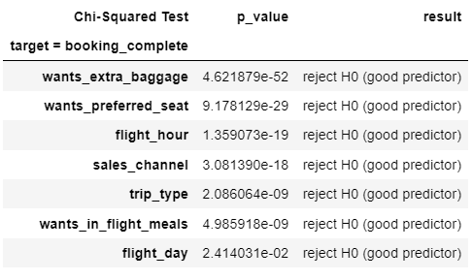

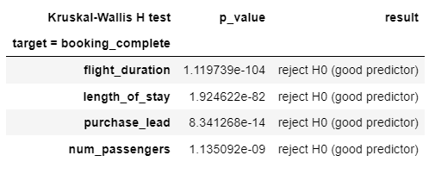
EDA Process
Univariate Analysis
Check:
distribution of each feature
Multivariate and Statistical Analysis
Check:
distribution of whether the booking is completed or not for each feature
pairplot & spearman-correlation
hypothesis testing
deep-dive analysis
Feature Engineering
Create more features, then evaluate them to increase the predictive power of Machine Learning model.
Re-engineered features with so many unique categories.
Features aggregation by summing them.
Perform cyclical encoding features for cyclical datetime data.
IMBALANCED CLASS PROBLEM!
All features are good predictors

Slide 11
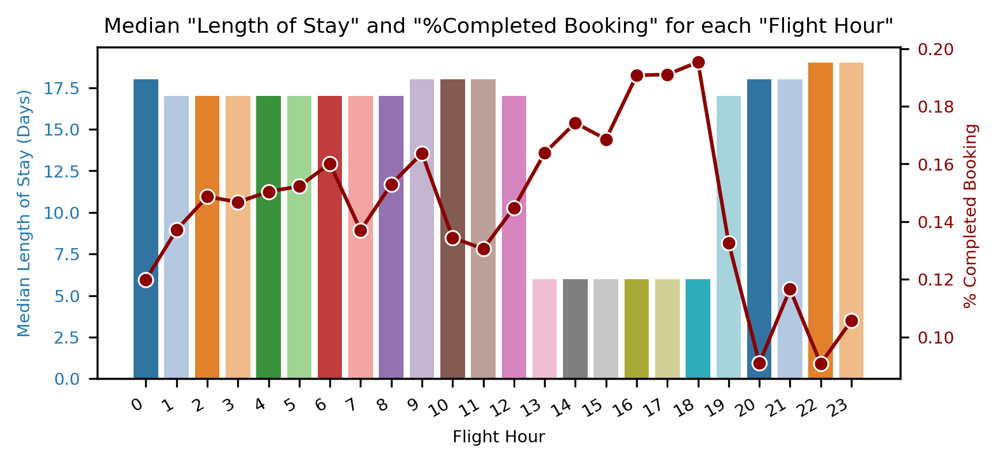
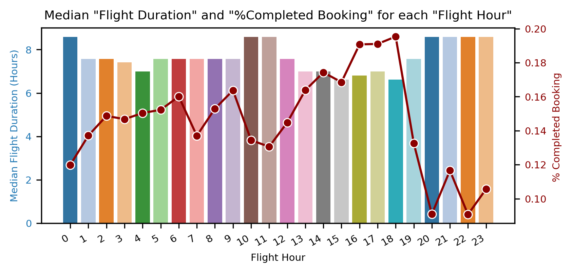
Deep-dive Analysis
Median Length of Stay is less than a week (7 day)
Customers choosing Afternoon Flights (13.00 to 18.00 Flight Hour) are more likely to complete their bookings,and those customers are most likely the ones who spend less than a week on their destination and have quite lower flight duration.
Median Flight Duration is lesser than the other Flight Hour

Slide 12
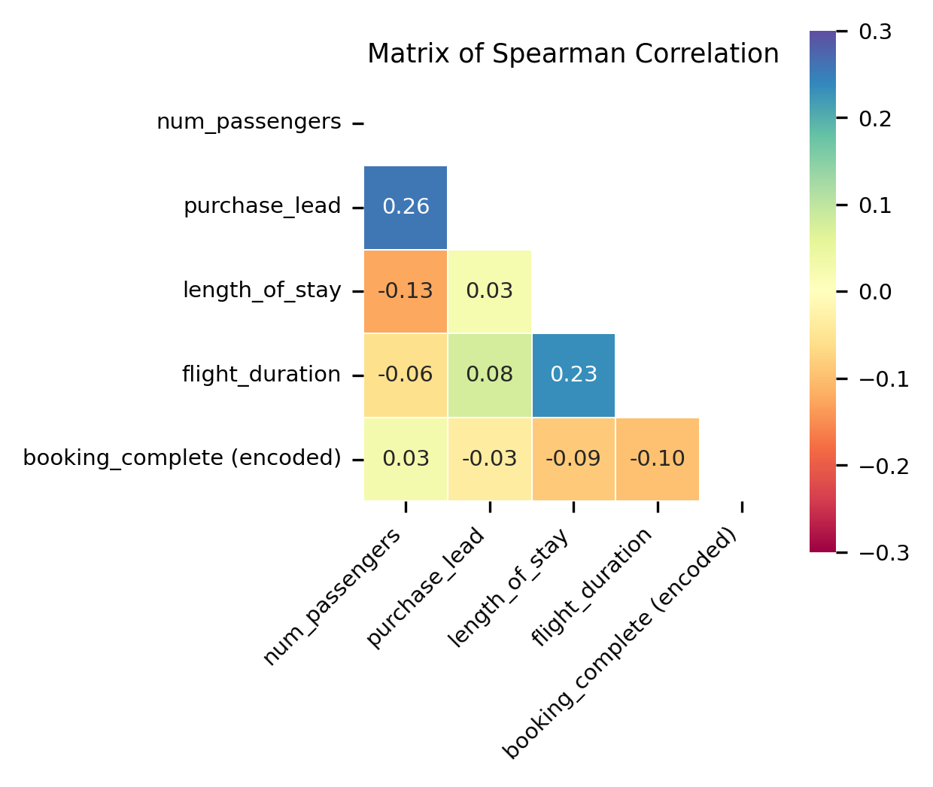
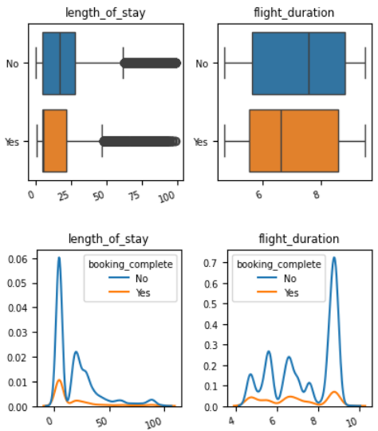
Deep-dive Analysis
Moreover, there is a relatively small positive relationship between Length of Stay and Flight Duration (spearman corr = 0.23), and
if we see the boxplot, customers with lower Flight Duration and Length of Stay are more likely to complete their bookings.
we found that this is more likely to happen for customers choosing Afternoon Flights!

Slide 13
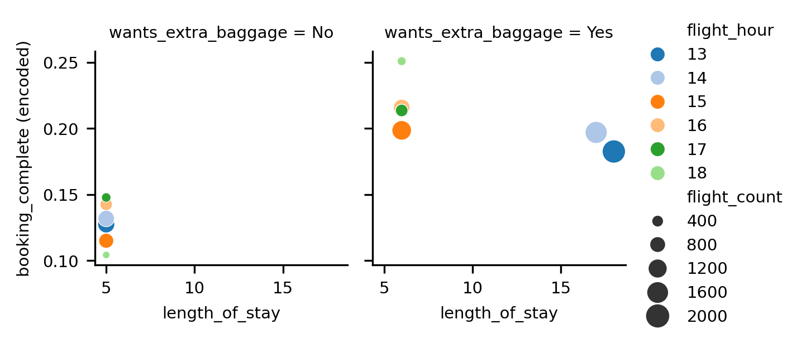
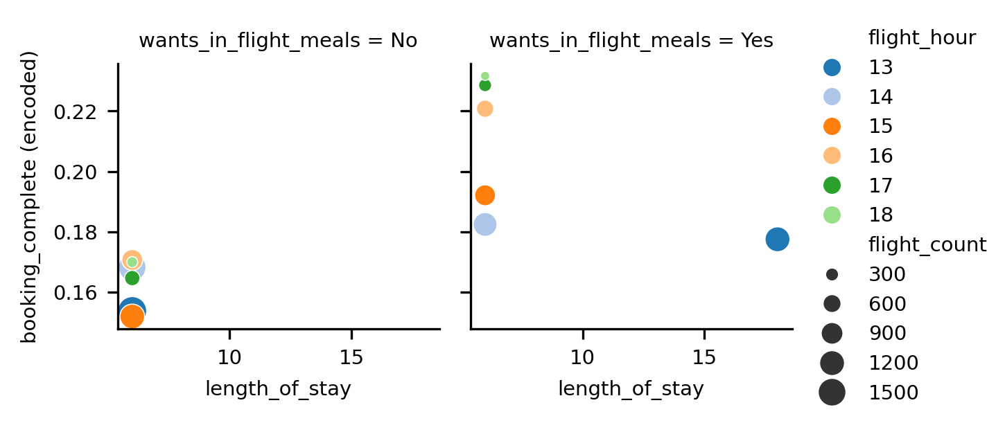
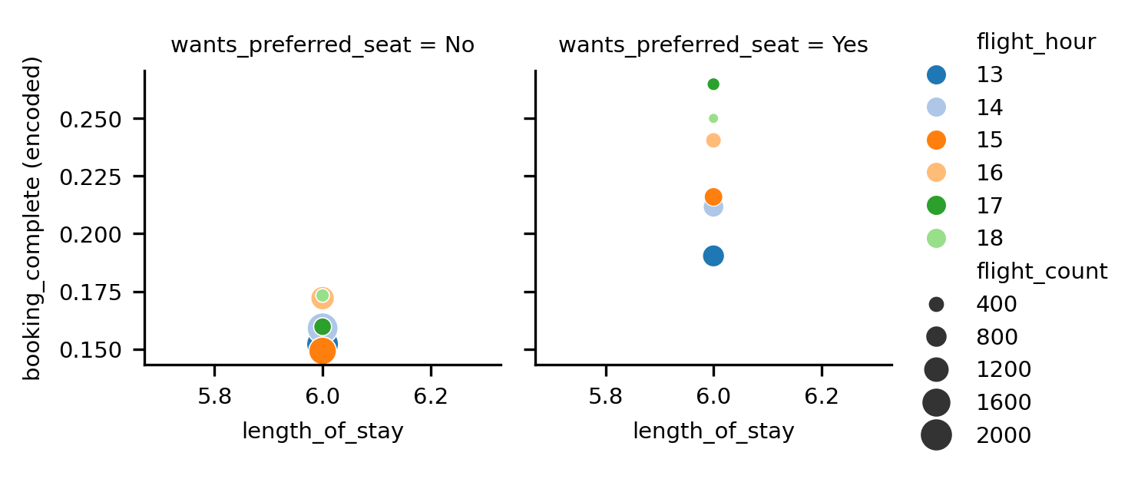
Deep-dive Analysis
From the scatterplot, we plot the data only for only Afternoon Flights and differentiate between wheter the customers want extra feature (wants_extra_baggage, wants_preferred_seat, and wants_in_flight_meals) or not.
Turns out that our customers having Afternoon Flights and Length of Stay less than a week are more likely to complete their bookings when wanting some extra features.

Slide 14
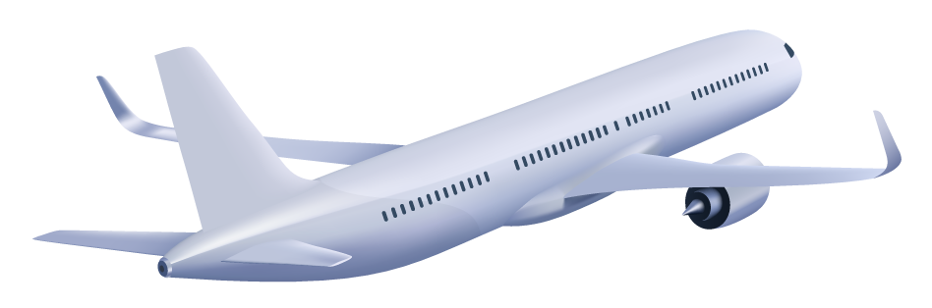
04
Modeling
Building, Evaluating, and Interpreting LightGBM model

Slide 15





Modeling Process
Data Preprocessing
Build LightGBM Model
Model Evaluation
Hyperparameter Tuning
Model Interpretation
One-Hot Encoding
Baseline Model
Randomized Search CV
Feature Importances
Undersampling Strategy (Random)
Oversampling Strategy (ADASYN)
Class Weighting Strategy

Slide 16
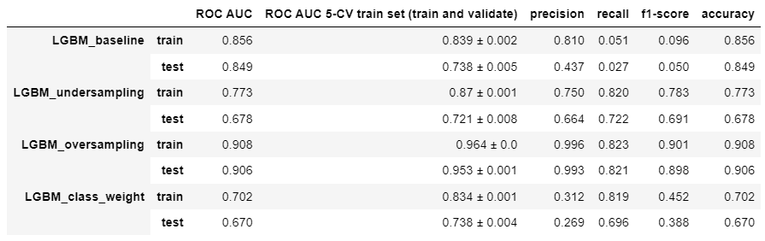
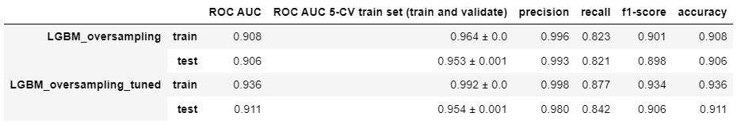
Model Evaluation and Hyperparameter Tuning
Among 3 strategies used to handle imbalanced class, Oversampling Strategy (ADASYN) – LGBM_oversampling results in the best performance on all evaluation metrics given, and has out-perform the other models far away.
LGBM_oversampling_tuned has better performance than LGBM_oversampling.
All the evaluation score metrics on the test set has been improved after hyperparameter tuning.
The best model (LGBM_oversampling_tuned) has 0.906 F1-score and 0.911 Accuracy on the test set.

Slide 17
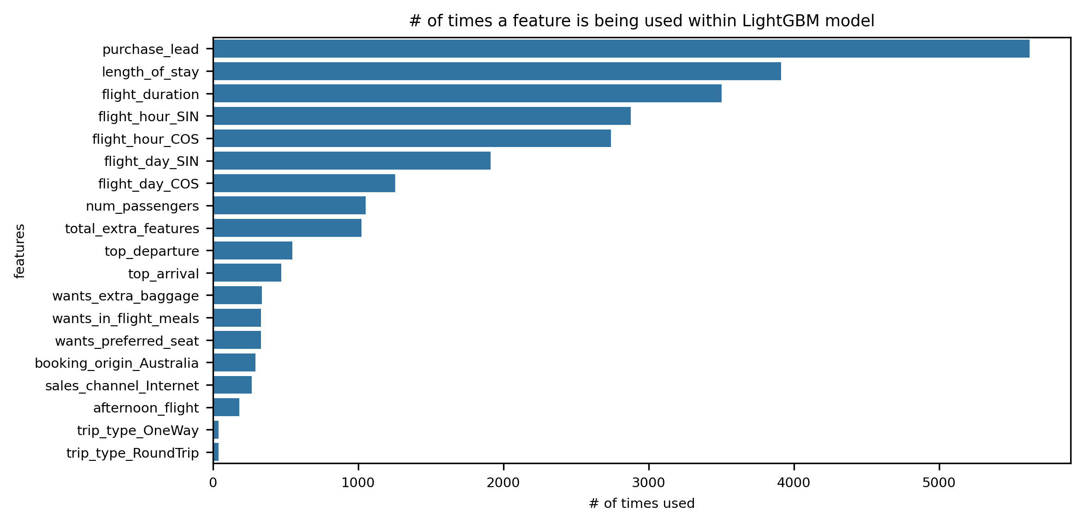
Model Interpretation
This is what we expect from EDA section previously where there is a tendency of customers to complete their bookings when choosing a particular Flight Hour, that is Afternoon Flights, and they have relatively shorter Flight Duration and Length of Stay.
Surprisingly it looks like that choosing a particular Flight Day influences customers booking behaviour, Maybe weekend or not weekend booking would influence their behaviour.
Moreover, Purchase Lead is at the 1st ranking most used feature within the model although it is not at the 1st ranking of the lowest p-value in hypothesis testing.
The bottom most important features is Trip Type which is pretty obvious since this feature has a dominant category value to "RoundTrip“, and this is what we expect.
Please note that "Feature Importances" does NOT tell us how each feature contributes to the output model. It just tells us how many times each feature is being used within the model. Probably we should use other model interpretation techniques, such as SHAP values, if we want to know contribution of each feature to the model.
The top 5 most importance features are
Purchase Lead
Length of Stay
Flight Duration
Flight Hour which is decomposed to flight_hour_SIN X flight_hour_COS
Flight Day which is decomposed to flight_day_SIN X flight_day_COS

Slide 18
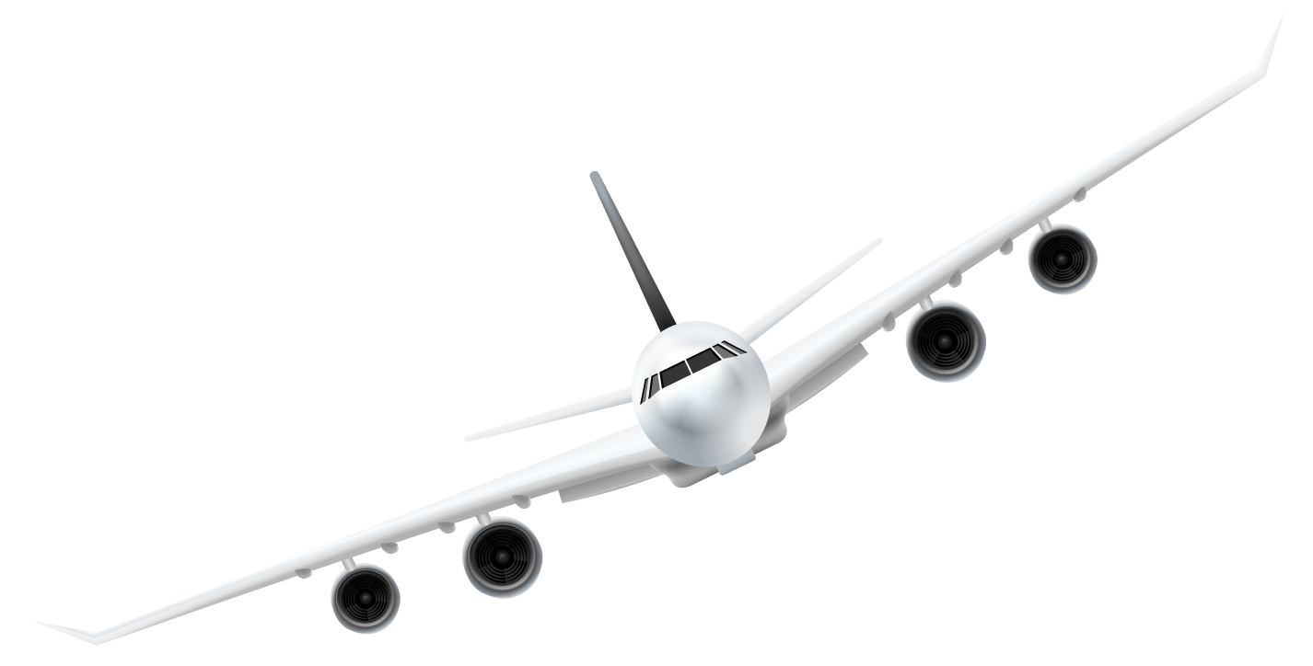
05
Recommendations
Recommendations for British Airways

Slide 19
Recommendations
Seems there is particular preference from customers of choosing Afternoon Flights, we have to ask their reasons of why they choose a particular flight hour. By doing so, we can further analyze and make even better strategy to meet their needs.
Focus on developing business strategy in Afternoon Flights , specifically for those having short trip and stay duration. Such as,
Increasing the number of aircraft for Afternoon Flights so that sufficient seat stock is always available.
Offering a promo/discount in Afternoon Flights for increasing the amount of bookings. Such as giving them higher flight discount if they want to add 3 extra features i.e. baggage, preferred seat, and meals, and then making a product bundling of extra baggage and meals or performing upselling strategy e.g if a customer wants extra baggage, we can offer to her/him an extra meals with lower price.
We see on the “Model Interpretation section” that Purchase Lead is at the 1st ranking of feature importances. We should consider to more deeply analyze this feature for further improvement of this project. Perhaps we could gain more insights by doing this.

Slide 20




Thanks!
Feel free to connect with me!

